Slide 1
BNZ Data Engineering Assessment
Sridar Venkatesan
Data Engineer
Submission Date:23-11-2022

Slide 2
Overview
The bank wants to investigate the nature of customers who have opened accounts recently for next best action & recommendation.
Requirement –
List of all accounts to be included in the investigation with appropriate opening date
List of all accounts to be included in the investigation with appropriate opening date
Identify The proportion of customers that have opened a credit card since the 1 July 2018 for each of the following age ranges: 18 – 29, 30 – 44, 45 – 59, 60+. Credit card accounts have a product type of ‘CCRD’ or ‘BUSS’.

Slide 3
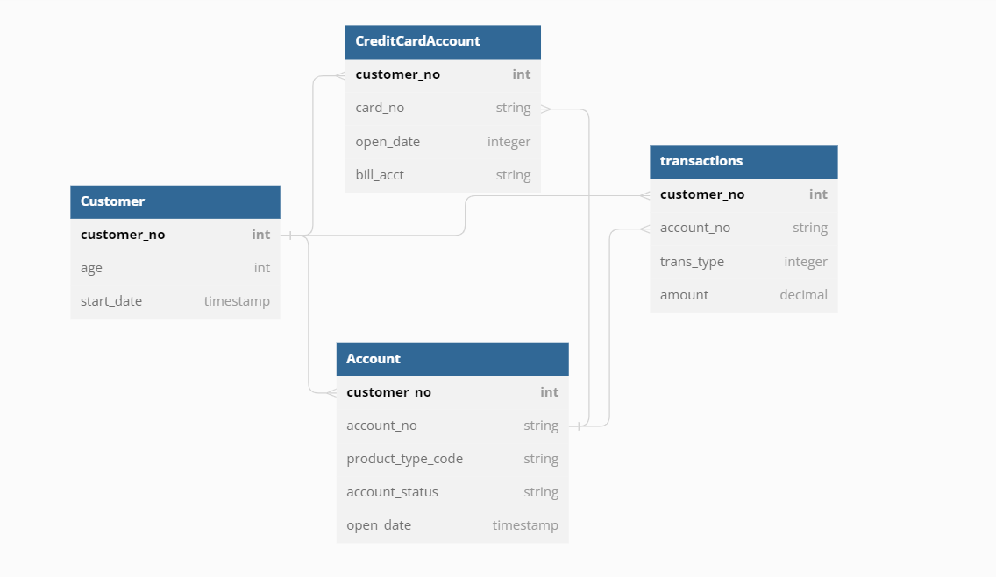
Data Model - Sources
Customer –
full list of customers and their attributes from system 1
Account –
full list of all accounts (eg credit cards, transaction, savings, home loans, etc.) and attributes from system 1
Creditcardaccount –
list of credit card accounts and attributes from system 2
Transaction –
all transactions for the last year for all accounts from system 1

Slide 4
Solution Assumptions
BNZAnalytics data for this assessment is hosted in Postgres Database
Additional Mock up data are created wherever applicable. Note that for scenario 2 and scenario 3, Data post July’18 is not available.
Airflow is hosted on EC2 instance and running as a docker container

Slide 5
Solution Methodology
Option 1 – Using Airflow & SQL
Create SQL scripts for each scenarios
Use built-in Postgres Operator to invoke the SQL scripts
Invoke schedule based on dataset update(New feature in Airflow v2.4)
Configure Notification
Pros:
Easy to setup with 5 lines of code
Cons:
Workload on Database cluster
Option 2 – Using Airflow, AWS Glue, Pyspark
Setup crawler to scan through the Target DB to add the objects into Glue Catalog
Build Pyspark jobs by reading source objects as dataframe and create Spark Sql
Configure Notification
Pros:
Scalable as the compute is on Glue
Cons:
Little Complex to setup

Slide 6
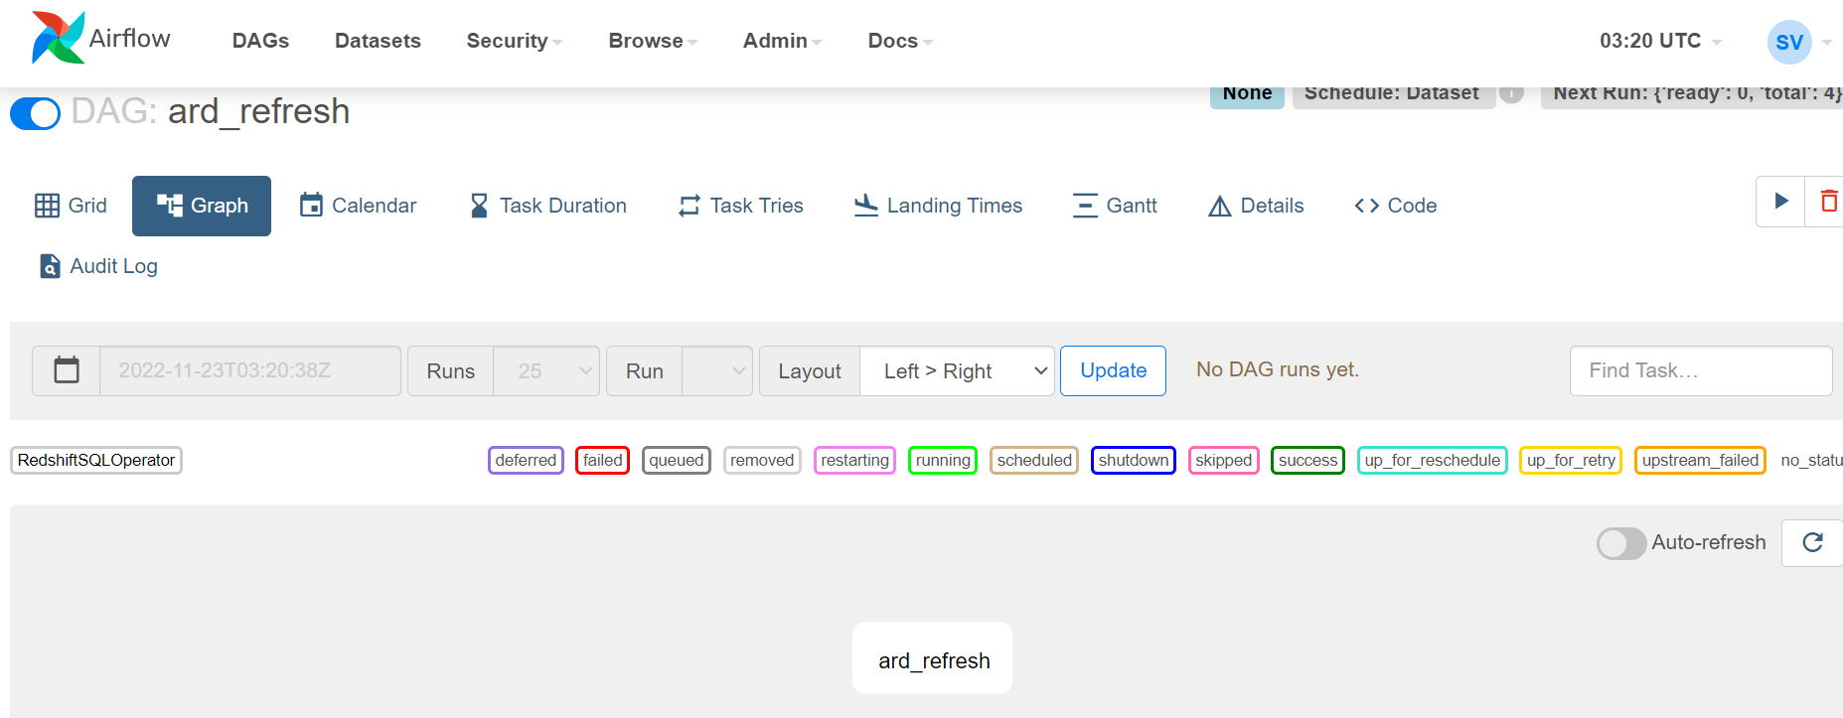
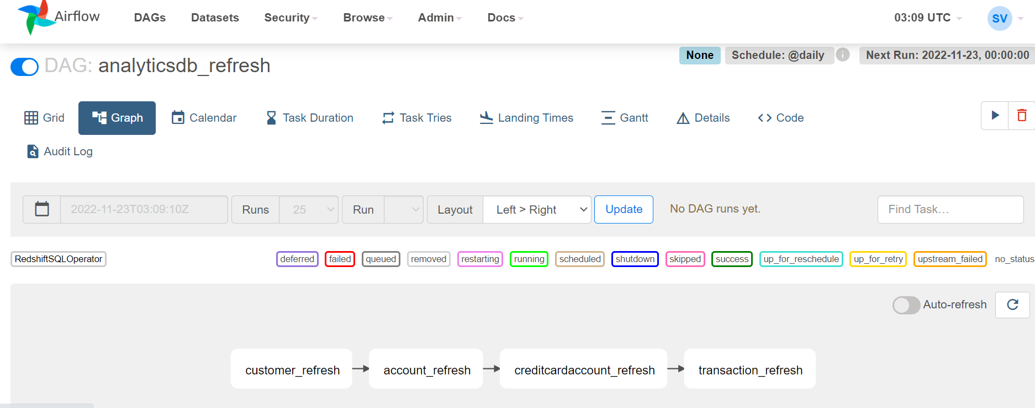
Option 1 - Airflow & SQL
Refresh Source Datasets
Generate ARD’s

Slide 7
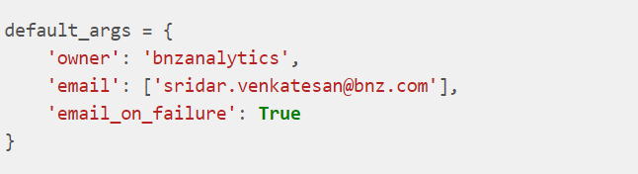
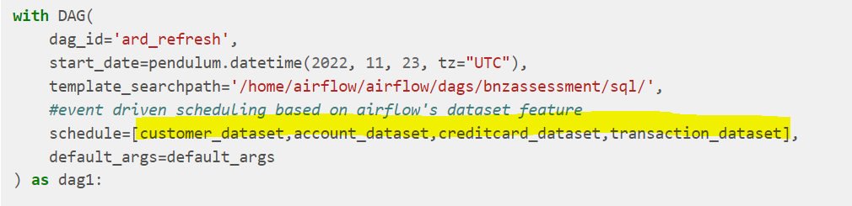
Option 1 - Airflow & SQL(Key features)
Event Driven Scheduling
Email Notification Enabled

Slide 8
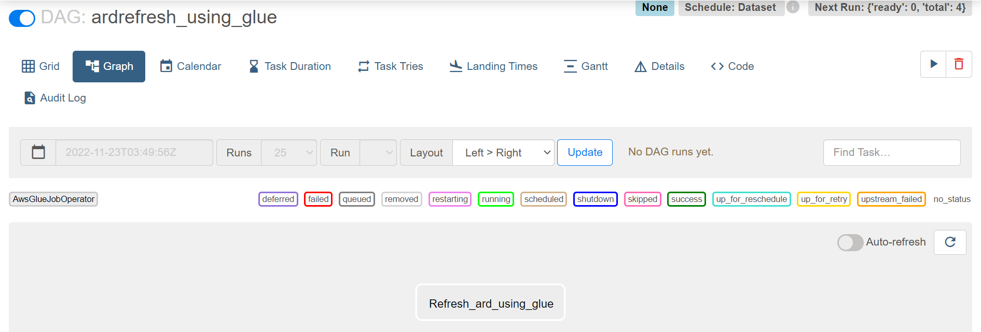
Option 2 - Using Airflow, AWS Glue, Pyspark
Refresh Source Datasets
Generate ARD’s using Glue

